Slide 1
PIP2001 Capstone Project
Review-1
PROJECT TITLE: INDIA VS POLLUTION
Batch Number:
Under the Supervision of,
Ms. Akkamahadevi
Dr./Mr./Ms./Prof.
Professor / Associate Professor / Assistant Professor
School of Computer Science and Engineering
Presidency University
Roll Number | Student Name
20211CSE0492 | Konduru Harshitha
20211CSE0493 | Dalavai Geetha Sree
20211CSE0126 | Metta Siva Nanda Reddy
Name of the Program:
Name of the HoD:
Name of the Program Project Coordinator:
Name of the School Project Coordinators: Dr. Sampath A K / Dr. Abdul Khadar A / Mr. Md Ziaur Rahman
Name of the Program: CSE
Name of the HoD: Dr. Blessed Prince P/Dr. Robin Rohit/Dr.Asif Mohammed H.B
Name of the Program Project Coordinator: Mr. Amarnath J.L & Dr. Jayanthi. K.
Name of the School Project Coordinators: Dr. Sampath A K / Dr. Abdul Khadar A / Mr. Md Ziaur Rahman

Slide 2
Introduction
Every day we come across several sources of pollution, polluting the very basics of our lives- Rivers, Land, Air and Noise. We know nothing about who/where to report it and how. We suggest an Innovative way to identify the sources of pollution in your area, get it prioritized through people votes, escalate it to the concerned authorities, keep a track of the progress and get notified of the actions taken. It will provide an End-2-End tool to battle pollution democratically partnering with Government

Slide 3
Literature Review
There are several applications and web platforms that allow users to report pollution incidents, typically involving the submission of photos and descriptions. However, these systems often lack automation in escalation and rely on users sending manual reports via emails or forms to the concerned authorities. This creates delays in addressing urgent environmental issues.
Most current reporting platforms do not incorporate a community voting mechanism to prioritize issues based on public concern. As a result, critical pollution problems may not get the attention they need, and authorities are often left to manually sort through reports without public input, leading to inefficient resource allocation.

Slide 4
Existing method Drawback
As with any online platform, there may be technical issues that could hinder the user experience, such as connectivity problems, app crashes, or difficulties in scheduling notifications.
Lack of a Centralized System: Most people are unaware of where or how to report environmental pollution, leading to fragmented efforts.
Manual and Time-Consuming Process: Current systems for reporting pollution, if they exist, are often manual, requiring individuals to contact specific departments or authorities. This process is slow and inefficient.

Slide 5
Proposed Method
An innovative, community-driven pollution reporting and monitoring platform using a mobile app or web interface. The platform aims to:
Allow users to report pollution via photos, descriptions, and geotagged locations.
Enable a voting system where community members can vote on reported issues, helping authorities prioritize.
Automate escalation of issues to the appropriate government bodies once certain thresholds are met.

Slide 6
Proposed Method
Track and notify users of the progress and actions taken on their reports.
Provide government bodies with a data dashboard to monitor pollution levels, complaints, and trends.

Slide 7
Objectives
Data-driven decision making for government bodies through a centralized dashboard.
Improve transparency by keeping users informed of the progress and actions taken on their reports.
Improve existing methodologies for efficient user experience
Empower citizens to report pollution in their community easily and effectively

Slide 8
Methodology/Modules
Reporting : Users report pollution incidents by uploading geotagged photos, descriptions, and optional tags.
Frontend: React.js for building the user interface for web and mobile compatibility.
Geolocation: Use HTML5 Geolocation API or Google Maps API to capture and display geotagged locations.
Community Engagement: Other users vote on the submitted reports to prioritize critical isuues. This crowdsourced ranking increases visibility for urgent matters.

Slide 9
Methodology/Modules
Voting system built using JavaScript and integrate into UI.
Node.js/Express for handling vote submissions and tallying votes.
MongoDB or Firebase for storing report and vote data in a structured format.
Escalation: Once a report crosses a set vote threshold, it is automatically escalated to the concerned authorities with a detailed incident report.
Business logic in Node.js that triggers an escalation using thresholds stored in the database.
Email integration for sending escalation emails to authorities.

Slide 10
Methodology/Modules
Progress Tracking: Authorities update the status of reports and users are notified via push notifications or email.
A React.js based dashboard for authorities to update report statuses.
Firebase Cloud Messaging (FCM) for sending notifications to users’ devices.
Dashboard and Analytics: Government officials access a data dashboard with aggregated data, showing pollution trends, and high-priority regions.
Based on report data , generating graphs, heatmaps, and other visual analytics.
Firebase or MongoDB to store pollution reports and metrics.

Slide 11
Methodology/Modules
Notifications: Both citizens and authorities receive updates on the status of reports, including actions taken, follow-ups, or the completion of an issue.
Socket.io for real-time updates to the web interface, enabling live status changes.

Slide 12
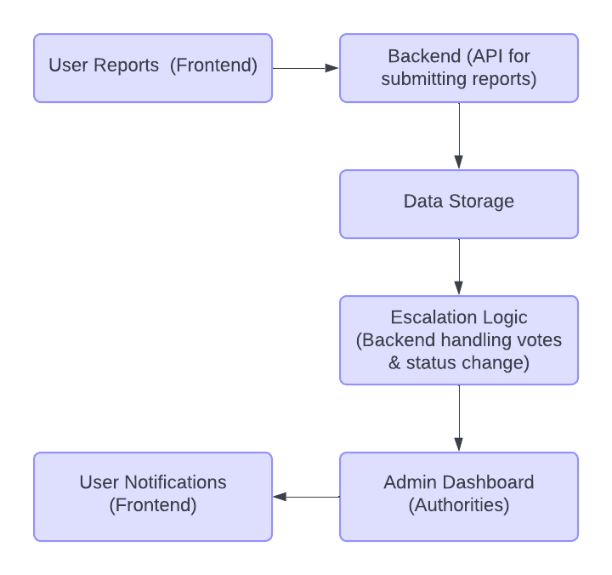
Architecture

Slide 13
Hardware/software components
Frontend: React.js.
Backend: Node.js/Express.js.
Database: MongoDB or Firebase.
APIs: Google Maps API, Geolocation API.
Notifications: Firebase Cloud Messaging, NodeMailer.

Slide 14
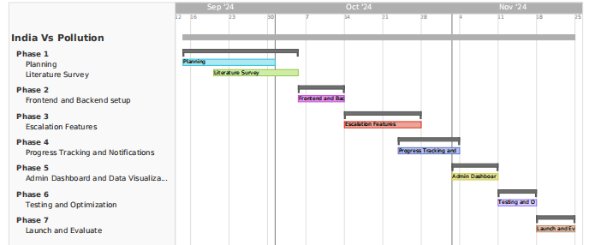
Timeline of Project

Slide 15
Expected Outcomes
Increased Public Participation: The platform will engage the community in reporting pollution, leading to more active and wide-reaching participation in environmental protection efforts.
Faster Pollution Control: Prioritization through public voting and automated issue escalation will speed up government response times.
Transparency: Citizens will receive real-time updates on their reports, building trust and engagement with the system.

Slide 16
Expected Outcomes
Better Data for Decision-Making: The government can make informed decisions based on pollution data, leading to more targeted and effective environmental policies.
Enhanced Accountability: With a structured reporting and escalation system, authorities will be more accountable for responding to pollution reports in a timely manner.

Slide 17
Conclusion
This platform empowers citizens to take an active role in reporting and prioritizing pollution issues in their communities through a user-friendly, democratic process. By leveraging modern technologies like geotagging, community voting, real-time notifications, and data-driven dashboards, it streamlines communication between the public and government authorities. The integration of automation, transparency, and accountability ensures that critical environmental issues are escalated efficiently, fostering a collaborative effort to combat pollution and improve quality of life.

Slide 18
Github Link
The Github link provided should have public access permission.
Github Link

Slide 19
References
Wing-Kwong Wong, Nguyen Thi Thuy Hang, Meng-Yuan Tsai, Guan-Cheng Shi, and Yo-Chen Tsai, “Web Service and a Mobile App for Reporting Site Pollution and Other Features”, IEEE, 2021
Miriam A. Carlos-Mancilla, José Raúl Castañeda Rosas, Monica Lozada-Muñoz, Omar Alí Zatarain Durán, Yehoshua Aguilar Molina, Rodolfo Omar Domínguez García, and Miriam Gonzalez Dueñas, “Development of an intelligent platform for obtaining environmental data”, IEEE, 2022
Rida Kanwal, Warda Rafaqat, Mansoor Iqbal, and Song Weiguo, “Exploratory Analysis of the Relationship between Wildfire Properties and Air Pollution in Chine under Sustainable Development”, IEEE, 2023

Slide 20
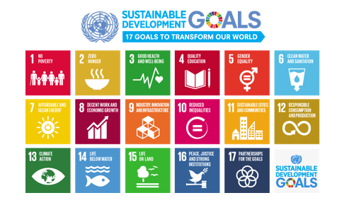
Project work mapping with SDG
This project aligns with SDG-13: Climate Action by empowering communities to actively report and prioritize environmental pollution, a key contributor to climate change. By enabling real-time reporting, raising public awareness, and facilitating prompt government response, the platform drives local actions to reduce pollution, fostering a cleaner environment and supporting global climate resilience efforts.

Slide 21
Thank You

